Slide 1
Sprint Review: SVOT & Renewals
Sprint 2
03 Mar – 28 Mar

Slide 2





Sprint Overview
Sprint Numbers
Sprint Links
Weeks
4
Sprint work Items Delivered
Work Items Delivered
36
UAT Items Addressed
8
Work Items To Test
Add the label ”Prod_Approved” to confirm the work item has delivered the functionality detailed in the Acceptance Criteria
Story Points Completed
79,25

Slide 3
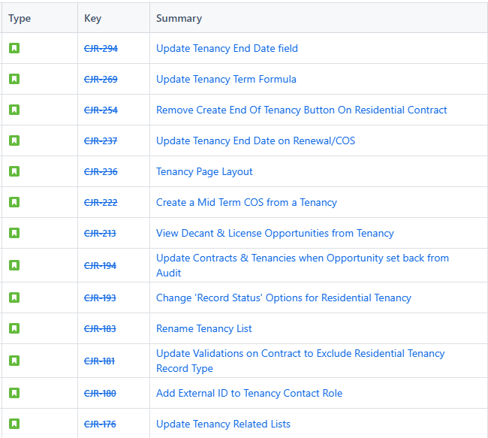
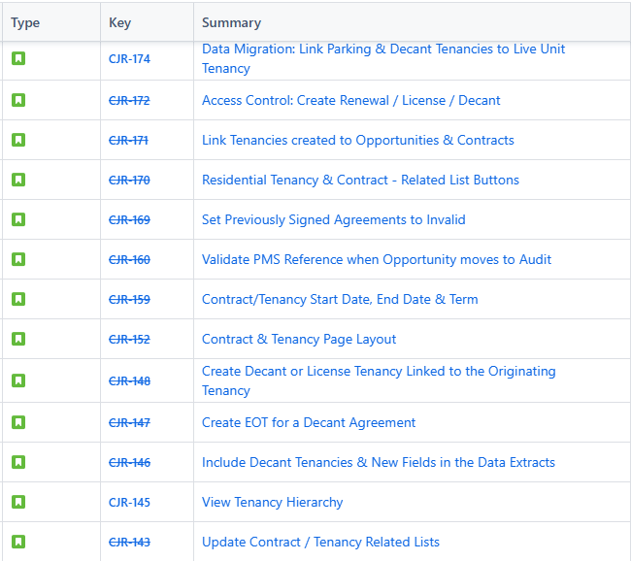
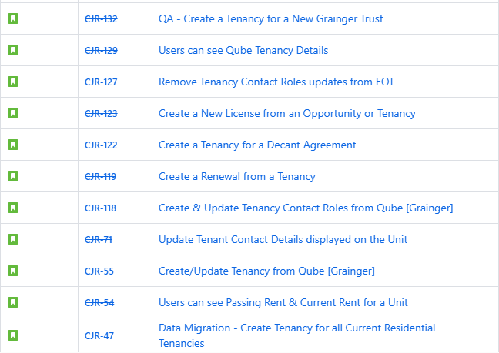
Work Items Delivered

Slide 4
General Items
Items Carried over to next Sprint | Reasons
CJR-302: Tenancy Term Calc (Bug Fix) | More complex formula/logic than initially believed.
Risk | Contributing factors | Impact | Decisions taken
None
Issue | Contributing factors | Impact | Decisions taken
None
Decision | Description | Date

Slide 5

Thank You

